Slide 1
Anatomy of NN

Slide 2
Outline
Anatomy of a NN
Design choices
Activation function
Loss function
Output units
Architecture

Slide 3
Outline
Anatomy of a NN
Design choices
Activation function
Loss function
Output units
Architecture

Slide 4
Anatomy of artificial neural network (ANN)
neuron
node
input
output
X
W
Y

Slide 5
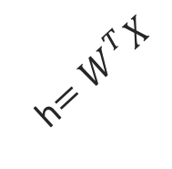
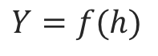
Anatomy of artificial neural network (ANN)
neuron
node
input
output
Affine transformation
$$Y=f(h)$$
Activation
X
Y
h$=W^{T}X$
We will talk later about the choice of activation function. So far we have only talked about sigmoid as an activation function but there are other choices.

Slide 6

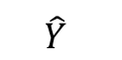
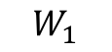
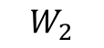
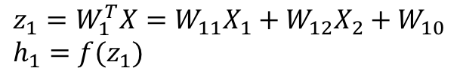
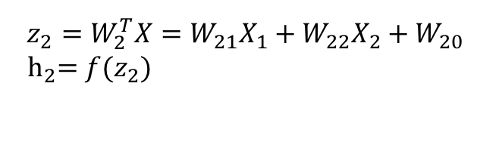
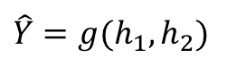
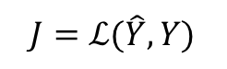
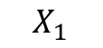
Anatomy of artificial neural network (ANN)
Input layer
hidden layer
output layer
$$z_{1}=W_{1}^{T}X=W_{11}X_{1}+W_{12}X_{2}+W_{10} \\ h_{1}=f(z_{1})$$
$$X_{1}$$
$$W_{1}$$
$$\hat{Y}$$
$$\hat{Y}=g(h_{1},h_{2})$$
$$J=ℒ(\hat{Y},Y)$$
Output function
Loss function
$$X_{2}$$
$$W_{2}$$
$$z_{2}=W_{2}^{T}X=W_{21}X_{1}+W_{22}X_{2}+W_{20}$$
$${ h}_{2}=f(z_{2})$$
We will talk later about the choice of the output layer and the loss function. So far we consider sigmoid as the output and log-bernouli.

Slide 7
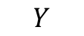
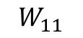
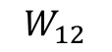
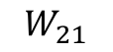
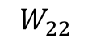
Anatomy of artificial neural network (ANN)
Input layer
hidden layer 1
hidden layer 2
output layer
$$X_{1}$$
$$W_{11}$$
$$W_{21}$$
$$Y$$
$$X_{2}$$
$$W_{12}$$
$$W_{22}$$

Slide 8
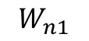
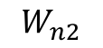
Anatomy of artificial neural network (ANN)
Input layer
hidden layer 1
hidden layer n
output layer
$$X_{1}$$
$$W_{11}$$
…
$$W_{n1}$$
$$Y$$
$$X_{2}$$
$$W_{12}$$
…
$$W_{n2}$$
We will talk later about the choice of the number of layers.

Slide 9
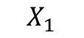
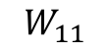
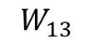
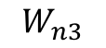
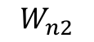
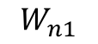
Anatomy of artificial neural network (ANN)
Input layer
hidden layer 1, 3 nodes
hidden layer n
3 nodes
output layer
$$W_{n1}$$
$$W_{11}$$
$$X_{1}$$
$$W_{12}$$
…
$$W_{n2}$$
$$Y$$
$$X_{2}$$
$$W_{13}$$
$$W_{n3}$$

Slide 10
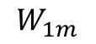
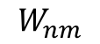
Anatomy of artificial neural network (ANN)
Input layer
hidden layer 1,
hidden layer n
output layer
m nodes
$$W_{n1}$$
$$W_{11}$$
$$X_{1}$$
m nodes
…
…
$$Y$$
$$X_{2}$$
$$W_{1m}$$
$$W_{nm}$$
We will talk later about the choice of the number of nodes.

Slide 11
Anatomy of artificial neural network (ANN)
Input layer
hidden layer 1,
hidden layer n
output layer
m nodes
$$W_{n1}$$
$$W_{11}$$
$$X_{1}$$
m nodes
Number of inputs d
…
…
$$Y$$
$$X_{2}$$
$$W_{1m}$$
$$W_{nm}$$
Number of inputs is specified by the data

Slide 12
Anatomy of artificial neural network (ANN)
input layer
output layer
hidden layer 1
hidden layer 2

Slide 13
Anatomy of artificial neural network (ANN)
input layer
output layer
hidden layer 1
hidden layer 2

Slide 14
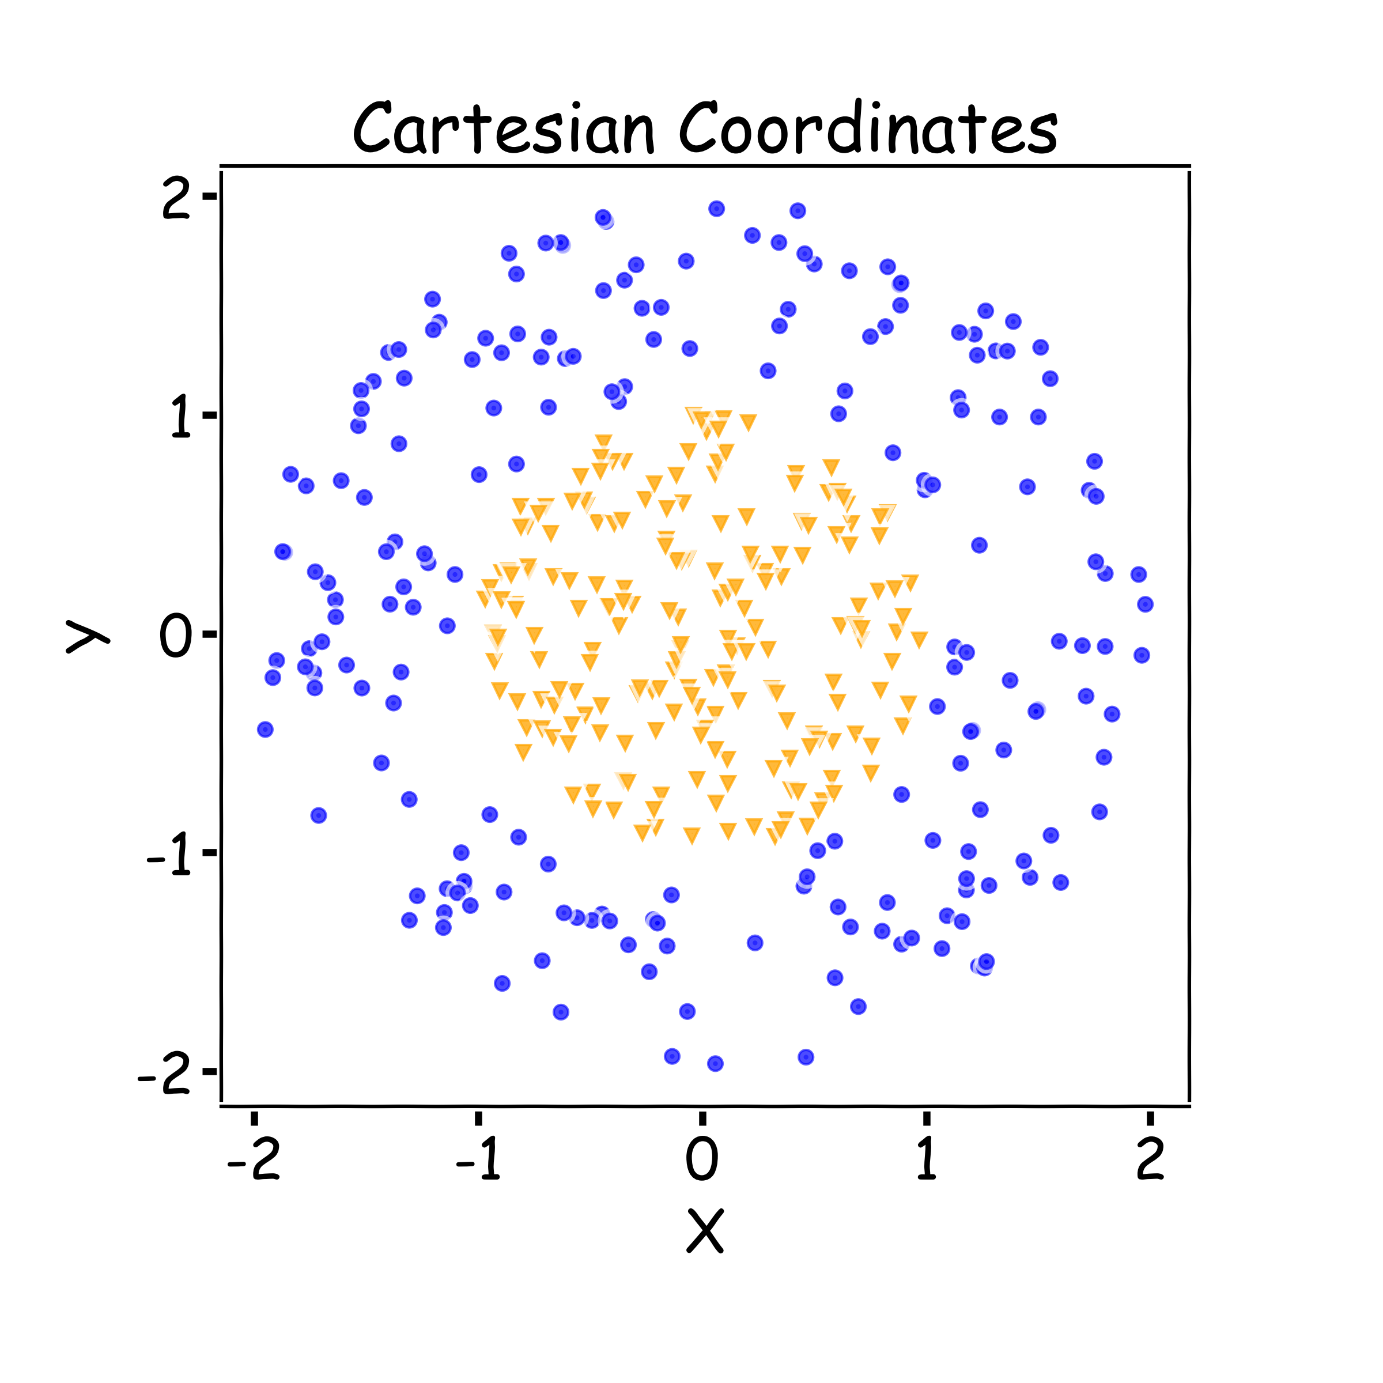
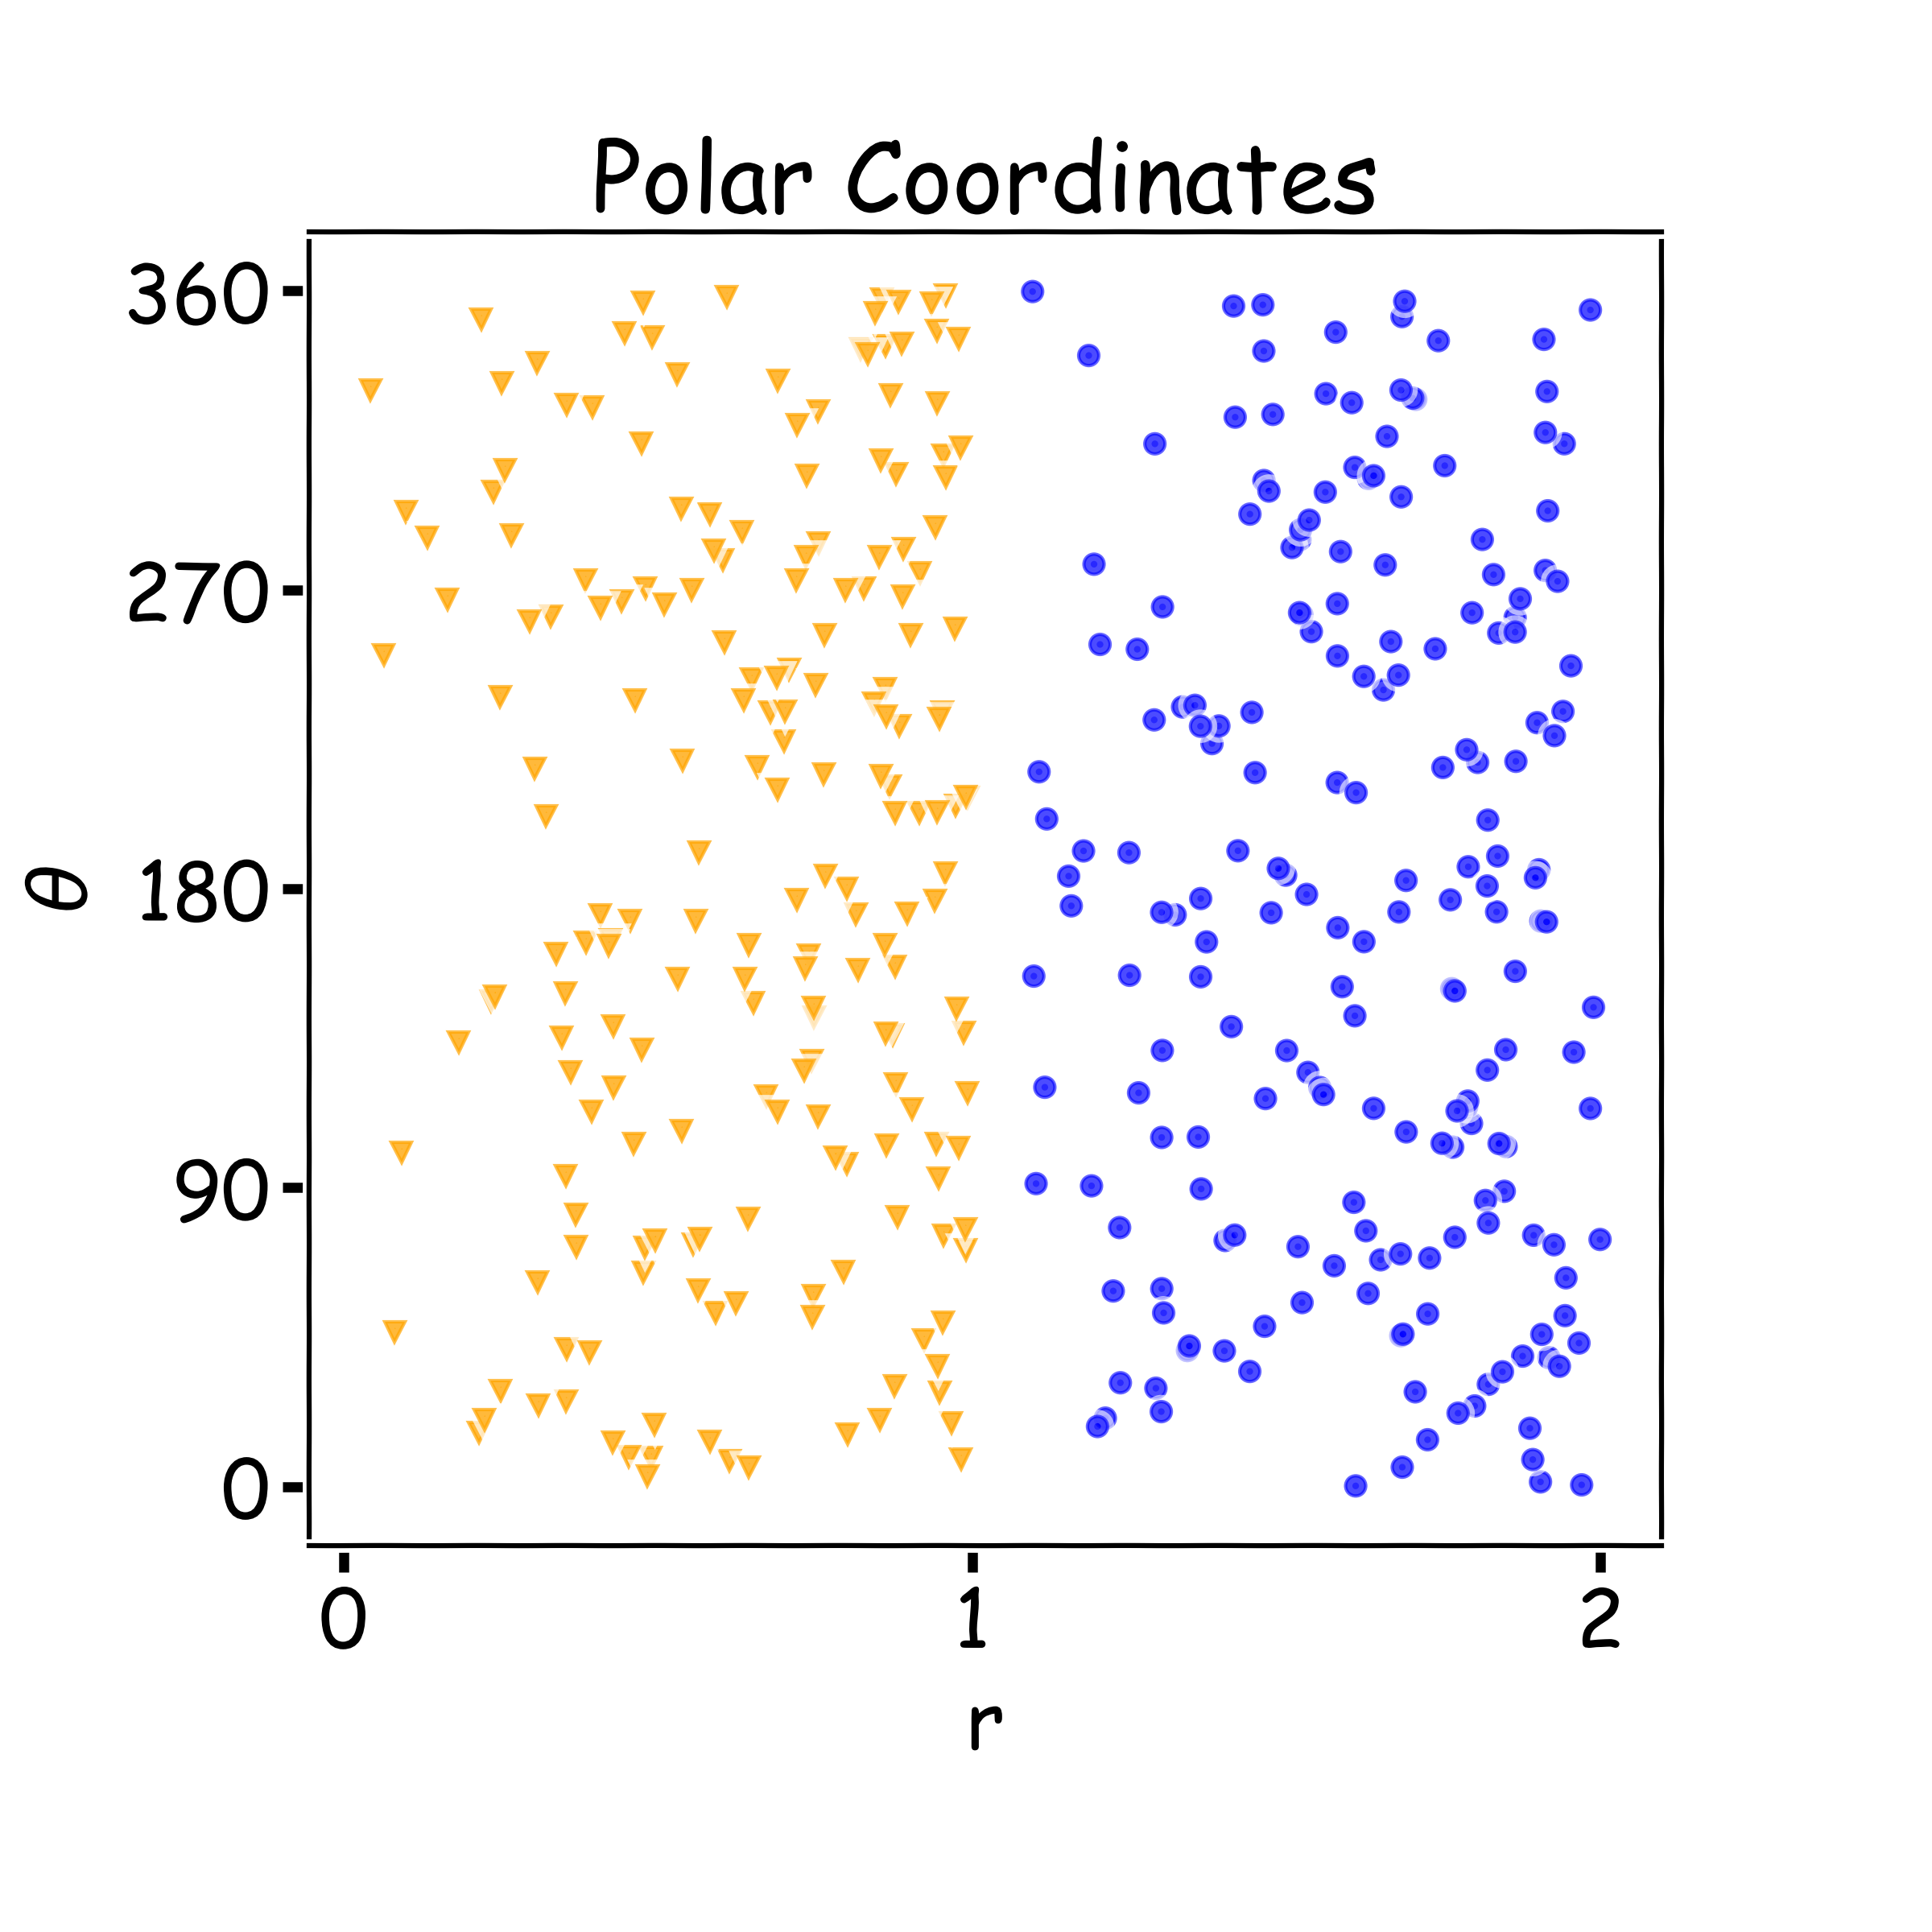
Why layers? Representation
Representation matters!

Slide 15
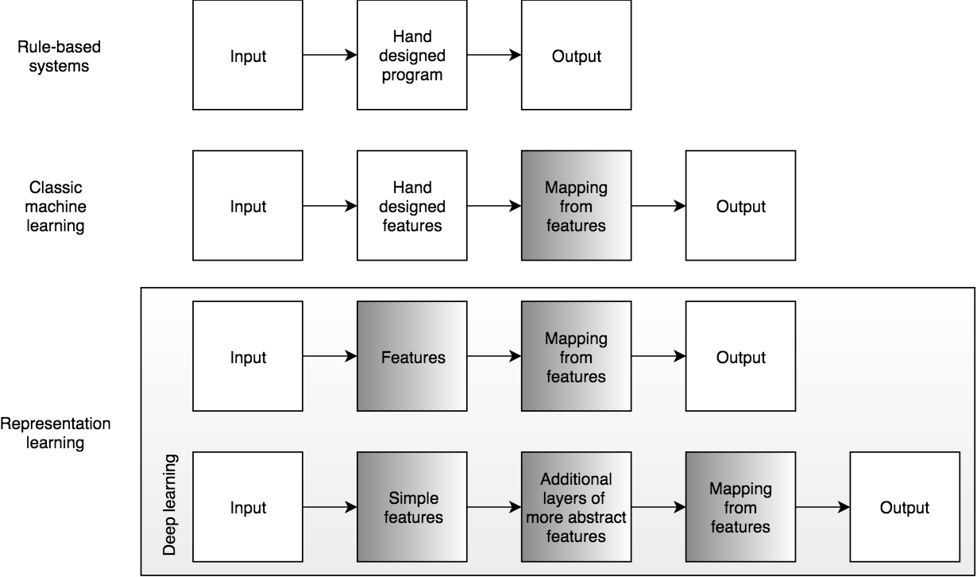
Learning Multiple Components

Slide 16
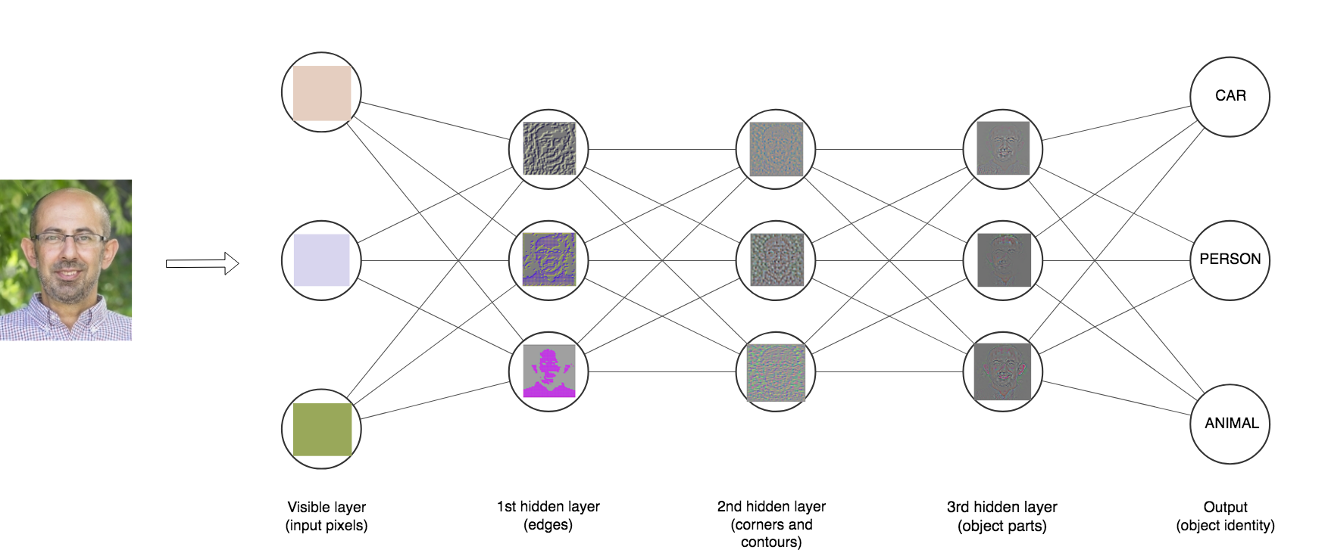

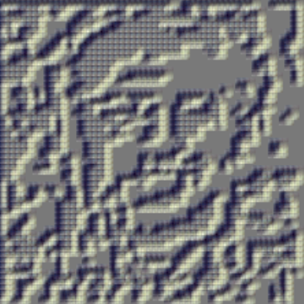
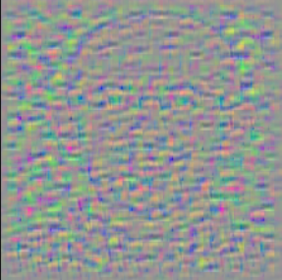


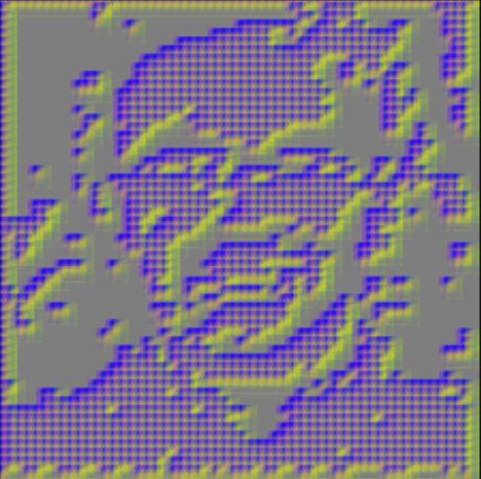
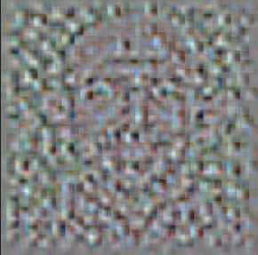
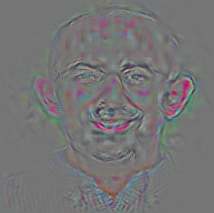
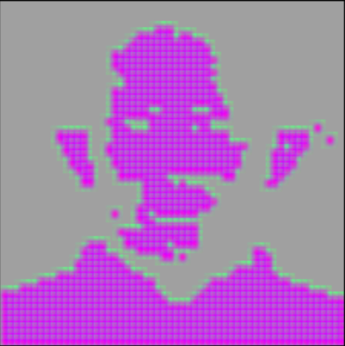
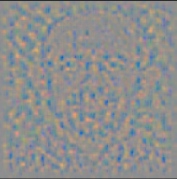


Depth = Repeated Compositions

Slide 17
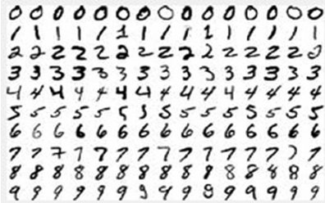
Neural Networks
Hand-written digit recognition: MNIST data

Slide 18
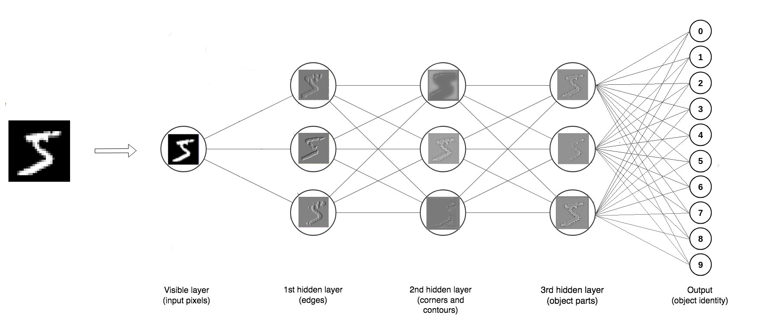
Depth = Repeated Compositions

Slide 19
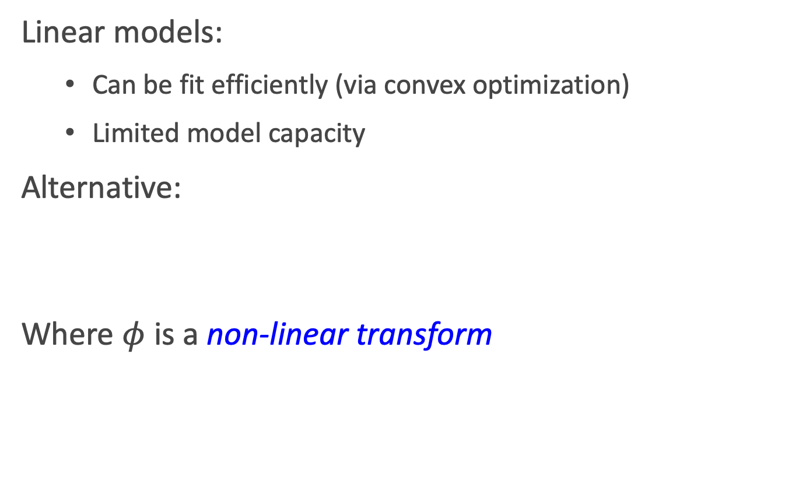
Beyond Linear Models
Linear models:
Can be fit efficiently (via convex optimization)
Limited model capacity
Alternative:
Where $φ$ is a non-linear transform

Slide 20
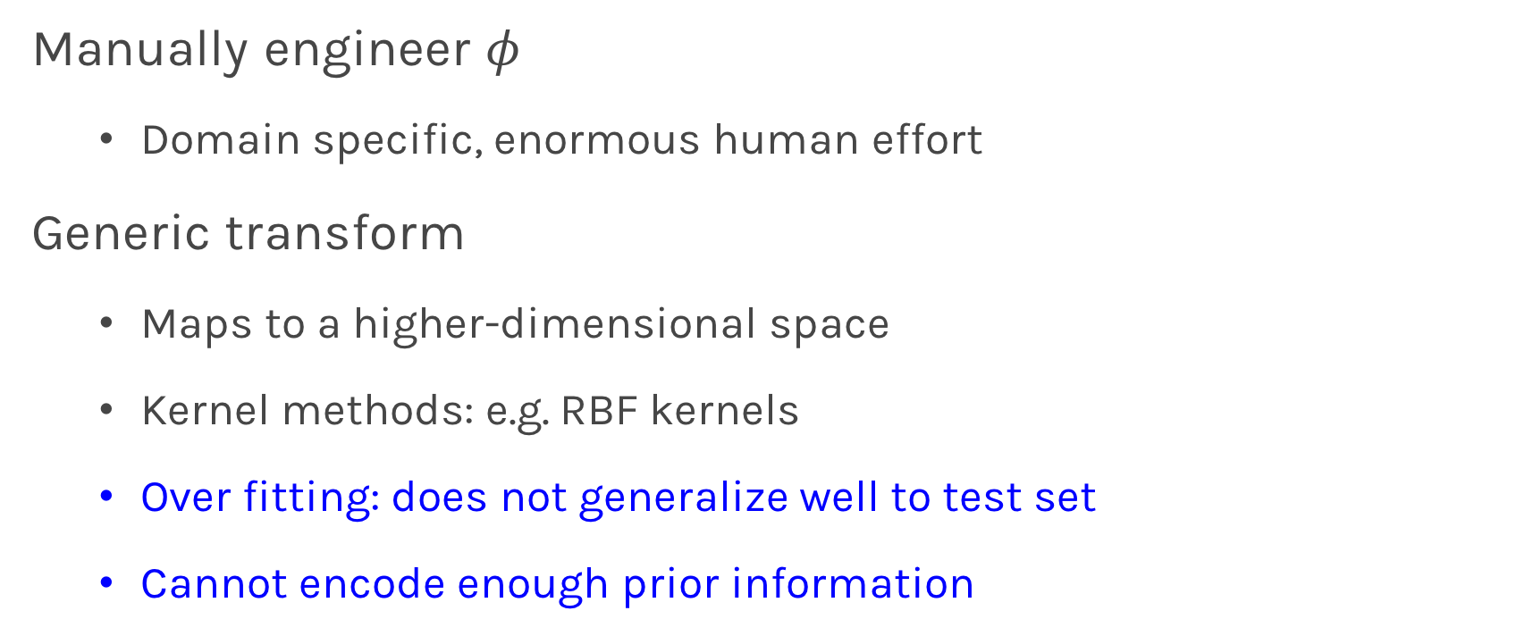
Traditional ML
Manually engineer $φ$
Domain specific, enormous human effort
Generic transform
Maps to a higher-dimensional space
Kernel methods: e.g. RBF kernels
Over fitting: does not generalize well to test set
Cannot encode enough prior information

Slide 21

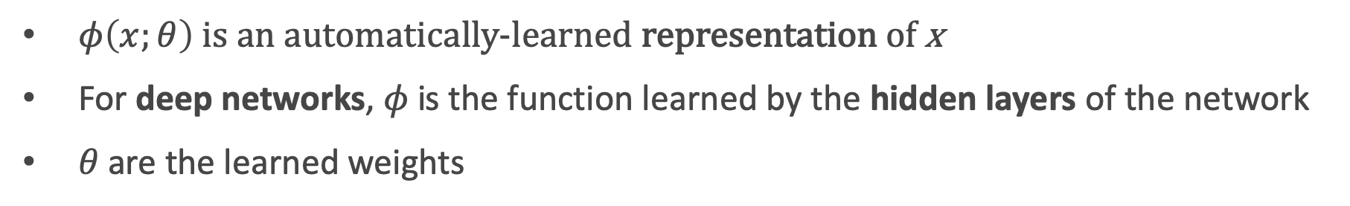
Deep Learning
Directly learn $φ$
$$f\left(x;θ\right)=W^{T}φ(x;θ)$$
$φ\left(x;θ\right)$ is an automatically-learned representation of x
For deep networks, $φ$is the function learned by the hidden layers of the network
$θ$ are the learned weights
Non-convex optimization
Can encode prior beliefs, generalizes well

Slide 22
Outline
Anatomy of a NN
Design choices
Activation function
Loss function
Output units
Architecture

Slide 23
Outline
Anatomy of a NN
Design choices
Activation function
Loss function
Output units
Architecture

Slide 24
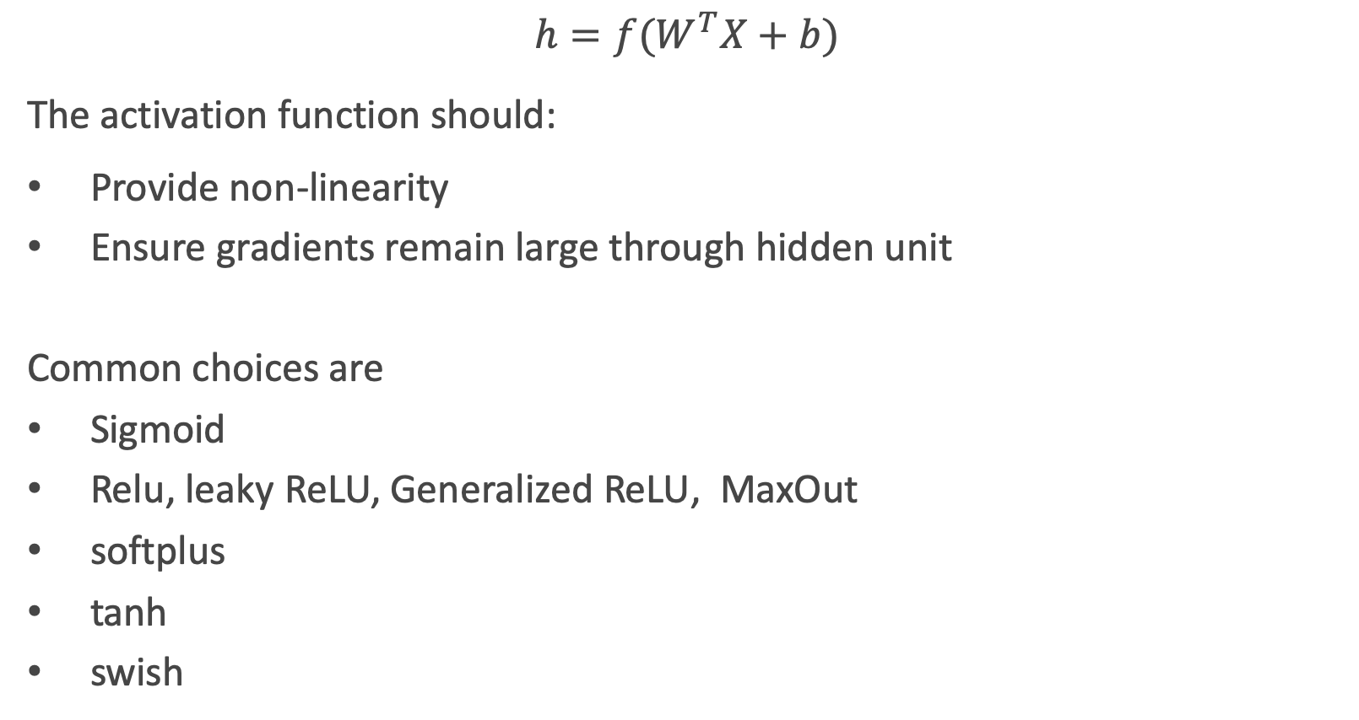
Activation function
$$h=f(W^{T}X+b)$$
The activation function should:
Provide non-linearity
Ensure gradients remain large through hidden unit
Common choices are
Sigmoid
Relu, leaky ReLU, Generalized ReLU, MaxOut
softplus
tanh
swish

Slide 25
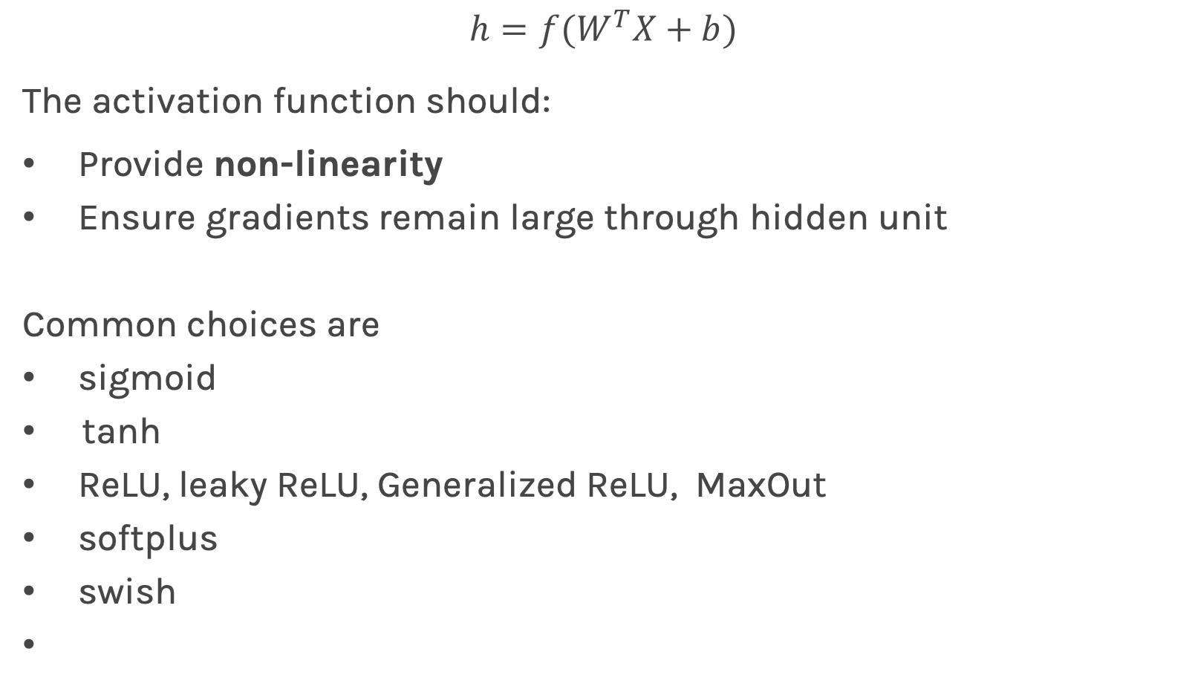
Activation function
$$h=f(W^{T}X+b)$$
The activation function should:
Provide non-linearity
Ensure gradients remain large through hidden unit
Common choices are
sigmoid
tanh
ReLU, leaky ReLU, Generalized ReLU, MaxOut
softplus
swish

Slide 26
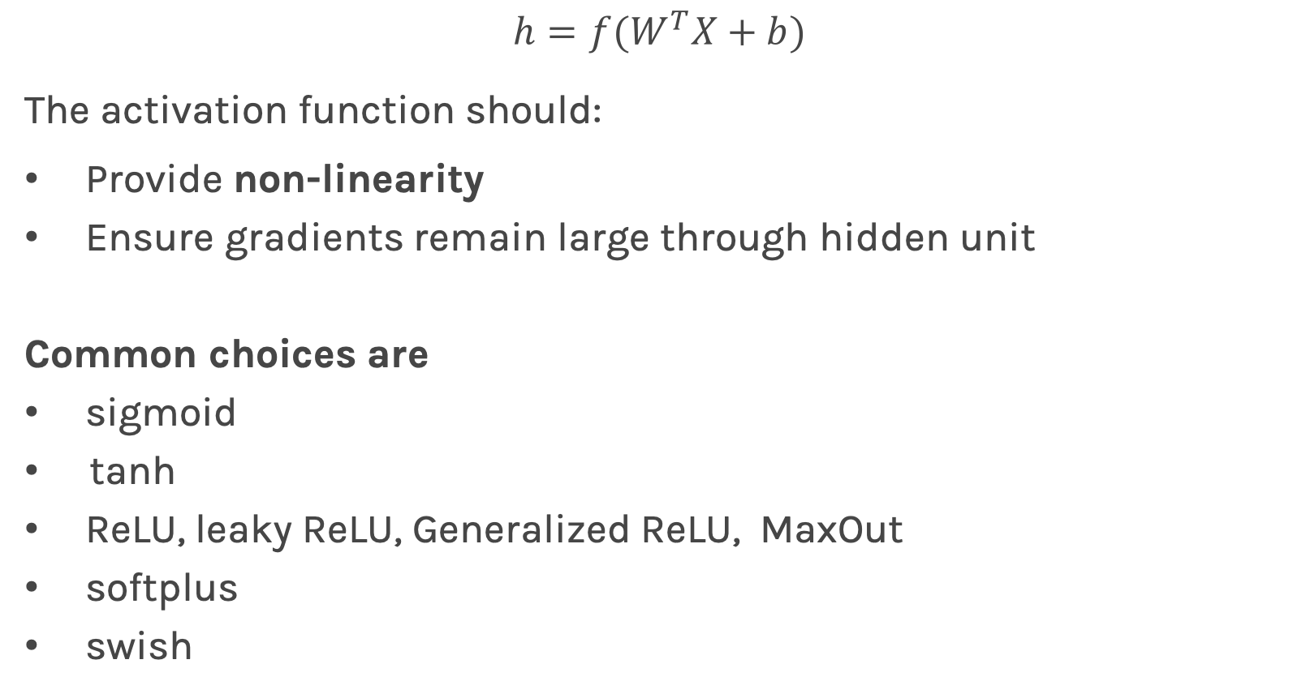
Activation function
$$h=f(W^{T}X+b)$$
The activation function should:
Provide non-linearity
Ensure gradients remain large through hidden unit
Common choices are
sigmoid
tanh
ReLU, leaky ReLU, Generalized ReLU, MaxOut
softplus
swish

Slide 27
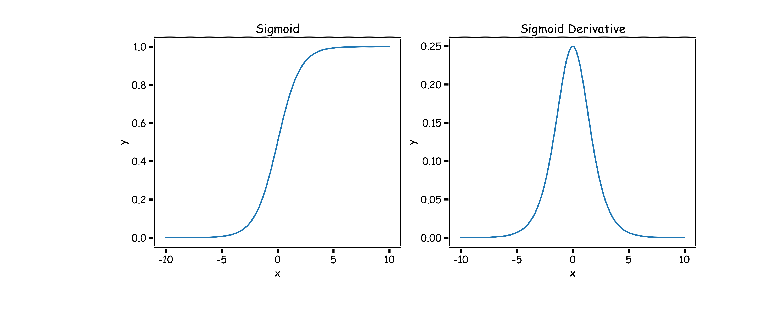
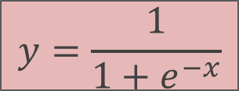
Sigmoid (aka Logistic)
$$y=\frac{1}{1+e^{−x}}$$
Derivative is zero for much of the domain. This leads to “vanishing gradients” in backpropagation.

Slide 28
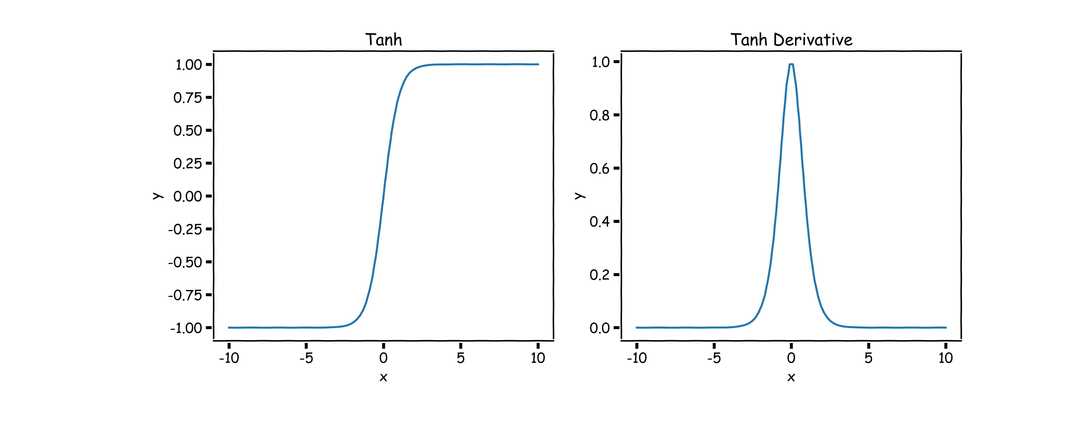
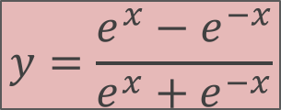
Hyperbolic Tangent (Tanh)
$$y=\frac{e^{x}−e^{−x}}{e^{x}+e^{−x}}$$
Same problem of “vanishing gradients” as sigmoid.

Slide 29
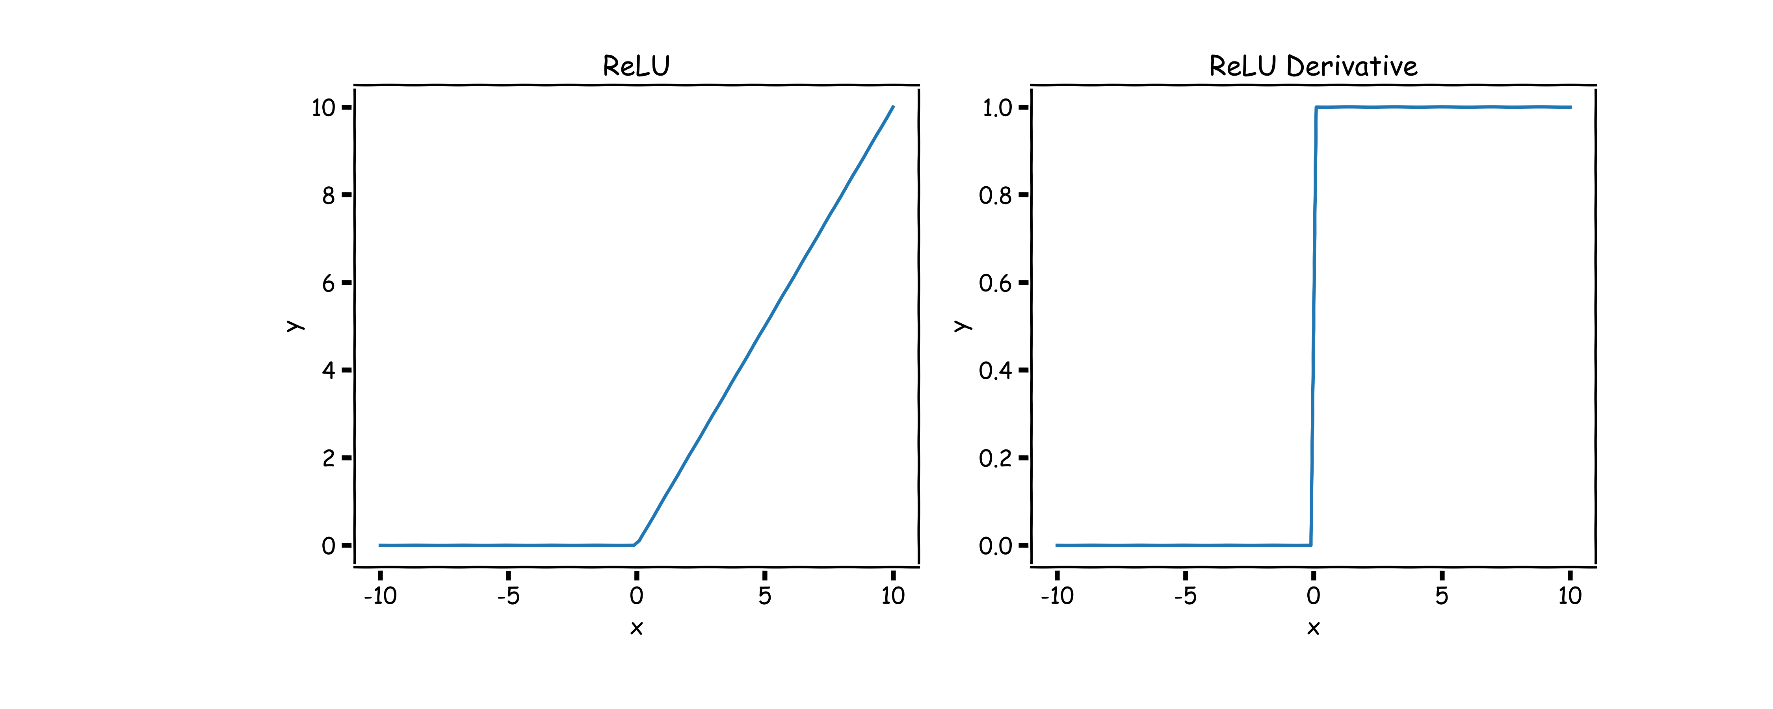

Rectified Linear Unit (ReLU)
$$y=max⁡(0,x)$$
Two major advantages:
No vanishing gradient when x > 0
Provides sparsity (regularization) since y = 0 when x < 0

Slide 30


Leaky ReLU
$$y=\max\left(0,x\right)+α\min{(0,1)}$$
where $α$ takes a small value
Tries to fix “dying ReLU” problem: derivative is non-zero everywhere.
Some people report success with this form of activation function, but the results are not always consistent

Slide 31


Generalized ReLU
Generalization: For $α_{i}>0$
$$g\left(x_{i}, α\right)=\max\left\{a,x_{i}\right\}+α\min{\{0,x_{i}\}}$$

Slide 32


softplus
$$y=\log{(1+e^{x})}$$
The logistic sigmoid function is a smooth approximation of the derivative of the rectifier

Slide 33


Maxout
Max of k linear functions. Directly learn the activation function.
$$g(x)= \max_{i∈\{1,…,k\}}{α_{i}x_{i}+β}$$

Slide 34


Swish: A Self-Gated Activation Function
$$g\left(x\right)=x σ(x)$$
Currently, the most successful and widely-used activation function is the ReLU. Swish tends to work better than ReLU on deeper models across a number of challenging datasets.

Slide 36
Outline
Anatomy of a NN
Design choices
Activation function
Loss function
Output units
Architecture

Slide 37

Loss Function
Likelihood for a given measurement:
$$p\left(y_{i} | W;x_{i}\right)$$
Assume independency, likelihood for all measurements:
$$L\left(W;X,Y\right)=p\left(Y | W;X\right)=\prod_{i}{p\left(y_{i} | W;x_{i}\right)}$$
Maximize the likelihood, or equivalently maximize the log-likelihood:
$$\log{L(W;X,Y)=\sum_{i}{\log{p\left(y_{i} | W;x_{i}\right)}}}$$
Turn this into a loss function:
$$ℒ\left(W;X, Y\right)=−\log{L(W;X,Y)}$$

Slide 38


Loss Function
Do not need to design separate loss functions if we follow this simple procedure
Examples:
Distribution is Normal then likelihood is:
$$p\left(y_{i} | W;x_{i}\right)=\frac{1}{√\left\{2π^{2}σ\right\}}e^{−\frac{{\left(y_{i}−{\hat{y}}_{i}\right)}^{2}}{2σ^2}}$$
$ℒ\left(W;X, Y\right)=\sum_{i}{{\left(y_{i}−{\hat{y}}_{i}\right)}^{2}}$
Distribution is Bernouli then likelihood is:
$$p\left(y_{i} | W;x_{i}\right)=p_{i}^{y_{i}}{\left(1−p_{i}\right)}^{1−y_{i}}$$
$ℒ\left(W;X, Y\right)=−\sum_{i}{\left[y_{i}\log{p_{i}}+{(1−y}_{i})\log{(1−p_{i})}\right] }$
$$MSE$$
Binary Cross-Entropy

Slide 39

Loss Function
Distribution is Multinouli, then likelihood is:
$$p\left(y_{i} | W;x_{i}\right)=\prod_{k}{p}{\left(y_{i}=k\right)}^{𝕀(y_{i}=k)}$$
$ℒ\left(W;X, Y\right)=−\sum_{i}{\sum_{k}{𝕀\left(y_{i}=k\right)\log{p(y_{i}=k)} }}$
where k is the class and $𝕀(y_{i}=k$) is the indicator function.
Question: How do we know what distribution to use?
Cross-Entropy

Slide 40
Design Choices
Activation function
Loss function
Output units
Architecture
Optimizer

Slide 41
Output Units
Output Type | Output Distribution | Output layer | Loss Function
Binary

Slide 42
Output Units
Output Type | Output Distribution | Output layer | Loss Function
Binary | Bernoulli

Slide 43
Output Units
Output Type | Output Distribution | Output layer | Loss Function
Binary | Bernoulli |  | Binary Cross Entropy

Slide 44
Output Units
Output Type | Output Distribution | Output layer | Loss Function
Binary | Bernoulli | ? | Binary Cross Entropy

Slide 45





Output unit for binary classification
X
$$\hat{Y}=P(y=1)$$
OUTPUT UNIT
X
$$φ\left(X\right)$$
$$σ(φ)$$
$$\hat{Y}=P(y=1)$$
$$X⟹φ\left(X\right)⟹P\left(y=1\right)=\frac{1}{1+e^{−φ(X)}}$$

Slide 46
Output Units
Output Type | Output Distribution | Output layer | Cost Function
Binary | Bernoulli | Sigmoid | Binary Cross Entropy

Slide 47
Output Units
Output Type | Output Distribution | Output layer | Cost Function
Binary | Bernoulli | Sigmoid | Binary Cross Entropy
Discrete

Slide 48
Output Units
Output Type | Output Distribution | Output layer | Cost Function
Binary | Bernoulli | Sigmoid | Binary Cross Entropy
Discrete | Multinouli

Slide 49
Output Units
Output Type | Output Distribution | Output layer | Loss Function
Binary | Bernoulli | Sigmoid | Binary Cross Entropy
Discrete | Multinouli |  | Cross Entropy

Slide 50
Output Units
Output Type | Output Distribution | Output layer | Cost Function
Binary | Bernoulli | Sigmoid | Binary Cross Entropy
Discrete | Multinouli | ? | Cross Entropy

Slide 51

Output unit for multi-class classification
X
$$\hat{Y}=[P_{1},P_{2},P_{3}]$$
OUTPUT UNIT

Slide 52


SoftMax
$$φ_{k}\left(X\right)$$
$$\hat{Y}=\frac{e^{φ_{k}\left(X\right)}}{\sum_{k=1}^{K}{e^{φ_{k}\left(X\right)}}}$$
A score
Probability of A
rest of the network
B score
Probability of B
C score
Probability of C
OUTPUT UNIT

Slide 53

SoftMax
$$φ_{k}\left(X\right)$$
$$\hat{Y}=\frac{e^{φ_{k}\left(X\right)}}{\sum_{k=1}^{K}{e^{φ_{k}\left(X\right)}}}$$
A score
Probability of A
rest of the network
B score
SoftMax
Probability of B
C score
Probability of C
OUTPUT UNIT

Slide 54
SoftMax
$$φ_{k}\left(X\right)$$
$$\hat{Y}=\frac{e^{φ_{k}\left(X\right)}}{\sum_{k=1}^{K}{e^{φ_{k}\left(X\right)}}}$$
Probability of A
rest of the network
SoftMax
Probability of B
Probability of C
OUTPUT UNIT

Slide 55
Output Units
Output Type | Output Distribution | Output layer | Cost Function
Binary | Bernoulli | Sigmoid | Binary Cross Entropy
Discrete | Multinoulli | Softmax | Cross Entropy

Slide 56
Output Units
Output Type | Output Distribution | Output layer | Cost Function
Binary | Bernoulli | Sigmoid | Binary Cross Entropy
Discrete | Multinoulli | Softmax | Cross Entropy
Continuous

Slide 57
Output Units
Output Type | Output Distribution | Output layer | Cost Function
Binary | Bernoulli | Sigmoid | Binary Cross Entropy
Discrete | Multinoulli | Softmax | Cross Entropy
Continuous | Gaussian

Slide 58
Output Units
Output Type | Output Distribution | Output layer | Cost Function
Binary | Bernoulli | Sigmoid | Binary Cross Entropy
Discrete | Multinoulli | Softmax | Cross Entropy
Continuous | Gaussian |  | MSE

Slide 59
Output Units
Output Type | Output Distribution | Output layer | Cost Function
Binary | Bernoulli | Sigmoid | Binary Cross Entropy
Discrete | Multinoulli | Softmax | Cross Entropy
Continuous | Gaussian | ? | MSE

Slide 60




Output unit for regression
X
$$\hat{Y}$$
OUTPUT UNIT
X
$$φ\left(X\right)$$
W$φ$
$$\hat{Y}$$
$$X⟹φ\left(X\right)⟹\hat{Y}=Wφ(X)$$

Slide 61
Output Units
Output Type | Output Distribution | Output layer | Cost Function
Binary | Bernoulli | Sigmoid | Binary Cross Entropy
Discrete | Multinoulli | Softmax | Cross Entropy
Continuous | Gaussian | Linear | MSE

Slide 62
Output Units
Output Type | Output Distribution | Output layer | Cost Function
Binary | Bernoulli | Sigmoid | Binary Cross Entropy
Discrete | Multinoulli | Softmax | Cross Entropy
Continuous | Gaussian | Linear | MSE
Continuous | Arbitrary | -

Slide 63
Output Units
Output Type | Output Distribution | Output layer | Cost Function
Binary | Bernoulli | Sigmoid | Binary Cross Entropy
Discrete | Multinoulli | Softmax | Cross Entropy
Continuous | Gaussian | Linear | MSE
Continuous | Arbitrary | - | GANS

Slide 64
Design Choices
Activation function
Loss function
Output units
Architecture
Optimizer

Slide 65


NN in action

Slide 66


NN in action

Slide 67


NN in action

Slide 68

NN in action
…

Slide 69


NN in action

Slide 70


NN in action

Slide 71


NN in action

Slide 72






Universal Approximation Theorem
Think of a Neural Network as function approximation.
$$Y=f\left(x\right)+ε$$
$$Y=\hat{f}(x)+ε$$
NN: $⟹\hat{f}(x)$
One hidden layer is enough to represent an approximation of any function to an arbitrary degree of accuracy
So why deeper?
Shallow net may need (exponentially) more width
Shallow net may overfit more
$$W_{3}$$
$$\hat{Y}$$
$$W_{2}$$
$$W_{4}$$
depth
$$W_{1}$$
width

Slide 73

Better Generalization with Depth
(Goodfellow 2017)

Slide 74

Shallow Nets Overfit More
Depth helps, and it’s not just because of more parameters
Don’t worry about this word “convolutional”. It’s just a special type of neural network, often used for images.
(Goodfellow 2017)
The 11-layer net generalizes better on the test set when controlling for number of parameters.
The 3-layer nets perform worse on the test set, even with similar number of total parameters.

